Slide 1
Chapter 4: Advanced Assembly Programming
The PIC18 Microcontroller
Han-Way Huang
Minnesota State University, Mankato
June 2004

Slide 2
Signed Arithmetic
Some quantities can be positive or negative.
A negative number is represented by the 2’s complement of its magnitude.
The subtract and add instructions can handle negative number properly when they are represented in 2’s complement format.
Modulo Math
All computers uses limited number of bits to represent numbers.
- Adding 2⁸ to a number in an 8-bit computer does not affect the result.
Similarly, adding 2¹⁶ and 2³² to a number in a 16-bit and 32-bit computer do not affect the result.

Slide 3
Procedure for Signed 8-bit Multiplication
Step 1
Multiply two operands (op1 × op2) disregarding their signs.
Step 2
If op1 is negative, then subtract op2 from the upper byte of the product.
Step 3
if op2 is negative, then subtract op1 from the upper byte of the product.
Procedure for Signed 16-bit Multiplication
Step 1
Multiply two operands (op1 × op2) disregarding their signs.
Step 2
If op1 is negative, then subtract op2 from the upper 16 bits of the product.
Step 3
if op2 is negative, then subtract op1 from the upper 16 bits of the product.

Slide 4
Example 4.1 Write a program to compute the product of two 8-bit signed numbers
represented by data memory locations op1 and op2 and leave the product in file
registers PRODH and PRODL.
Solution:
#include <p18F8720.inc>
op1 set 0x00 ; the first operand
op2 set 0x01 ; the second operand
num1 equ 0x87 ; test number 1
num2 equ 0x98 ; test number 2
org 0x00 ; reset vector
goto start
org 0x08 ; high priority interrupt service routine
retfie
org 0x18 ; low priority interrupt service routine
retfie
start movlw num1 ; set up op1 for testing purpose
movwf op1,A ; “
movlw num2 ; set up op2 for testing purpose
movwf op2,A ; “
movf op1,W,A

Slide 5
mulwf op2,A
btfsc op2,7,A ; test the sign bit of the second operand
subwf PRODH,F,A ; if negative, eliminate extra term
movf op2,W,A
btfsc op1,7,A ; test the sign bit of the first operand
subwf PRODH,F,A ; if negative, eliminate extra term
nop
end
Example 4.2 Write a program to compute the product of two 16-bit signed integers and leave the product in memory locations represented by result ... result+3.
Solution:
#include <p18F8720.inc>
arg1_hi set 0x00 ; high byte of the first argument
arg1_lo set 0x01 ; low byte of the first argument
arg2_hi set 0x02 ; high byte of the second argument
arg2_lo set 0x03 ; low byte of the second argument
result set 0x04 ; location to hold the product
num1_hi equ 0x83 ; test number 1
num1_lo equ 0x45 ; “
num2_hi equ 0x81 ; test number 2
num2_lo equ 0x47 ; “

Slide 6
org 0x00 ; reset vector
goto start
… ; interrupt service routines
start movlw num1_hi ; set up test numbers
movwf arg1_hi ; "
movlw num1_lo ; "
movwf arg1_lo ; "
movlw num2_hi ; "
movwf arg2_hi ; "
movlw num2_lo ; "
movwf arg2_lo ; "
movf arg1_lo,W
mulwf arg2_lo ; compute arg1_lo × arg2_lo
movff PRODL,result
movff PRODH,result+1
movf arg1_hi,W
mulwf arg2_hi ; compute arg1_hi × arg2_hi
movff PRODL,result+2
movff PRODH,result+3
movf arg1_lo,W
mulwf arg2_hi ; compute arg1_lo × arg2_hi
movf PRODL,W
addwf result+1,F

Slide 7
movf PRODH,W
addwfc result+2,F
clrf WREG
addwfc result+3,F ; add carry to the most significant byte
movf arg1_hi,W
mulwf arg2_lo ; compute arg1_hi × arg2_lo
movf PRODL,W
addwf result+1,F
movf PRODH,W
addwfc result+2,F
clrf WREG ; add carry to the most significant byte
addwfc result+3,F ; "
btfss arg2_hi,7 ; check the sign of arg2
goto sign_arg1
movf arg1_lo,W
subwf result+2,F ; delete extra term
movf arg1_hi,W ; "
subwfb result+3,F ; "
sign_arg1 btfss arg1_hi,7 ; check the sign of arg1
goto more ; continue to perform other operation
movf arg2_lo,W
subwf result+2,F ; delete extra term

Slide 8
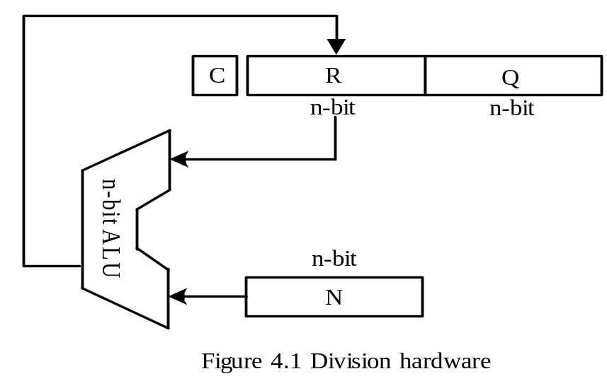
movf arg2_hi,W,A
subwfb result+3,F,A
more nop
end
Unsigned Divide Operation
Performed by repeated subtraction using the circuit shown in Figure 4.1.
Registers N, R, and Q are initialized to the divisor, 0, and the dividend.
R and Q will hold the remainder and quotient at the end of the division operation.

Slide 9
Algorithm for Unsigned Division
Repeat the following steps n times
Step 1
Shift the register pair (R, Q) one place to the left.
Step 2
Subtract the contents of N from R and put the result back to R if the result is nonnegative.
Step 3
If the result of Step 2 is negative, then set the least significant bit of Q to 0. Otherwise, set the least significant bit of Q to 1.
Example 4.4 Write a program to divide an unsigned 16-bit number into another unsigned 16-bit number.

Slide 10
#include <p18F8720.inc>
radix dec ; set default radix to decimal
lp_cnt set 0x00 ; loop count
temp set 0x01 ; temporary storage
dsr set 0x04 ; divisor
quo set 0x06 ; quotient
rem set 0x08 ; remainder
dd_h equ 0x68 ; high byte of dividend test number
dd_l equ 0x20 ; low byte of dividend test number
dr_h equ 0x01 ; high byte of divisor test number
dr_l equ 0x48 ; low byte of divisor test number
org 0x00
goto start
org 0x08
retfie
org 0x18
retfie
start movlw dd_h ; initialize Q register in Figure 4.1
movwf quo+1,A ; “
movlw dd_l ; “
movwf quo,A ; “
movlw dr_h ; initialize N register in Figure 4.1
movwf dsr+1,A ; “

Slide 11
movlw dr_l ; “
movwf dsr,A ; “
clrf rem,A ; initialize R register in Figure 4.1 to 0
clrf rem+1,A ; “
movlw 16
movwf lp_cnt,A ; initialize loop count to 16
loop bcf STATUS,C,A ; clear the C flag
rlcf quo,F,A ; rotate (R, Q) pair to the left one place
rlcf quo+1,F,A ; "
rlcf rem,F,A ; "
rlcf rem+1,F,A ; "
movf dsr,W,A
subwf rem,W,A
movwf temp,A ; save the low byte of the difference
movf dsr+1,W,A
subwfb rem+1,W,A
btfss STATUS,C ; skip if carry is 1
goto less
bsf quo,0,A ; set the quotient bit to 1
movwf rem+1,A ; place the difference in R register
movff temp,rem ; "

Slide 12
goto next
less bcf quo,0,A ; set the quotient bit to 0
next decfsz lp_cnt,F,A ; decrement the loop count and skip is zero
goto loop
nop
end
Signed Division
- When dividend and divisor differs in sign, the sign of the quotient is minus.
The sign of the remainder agrees with the dividend.
Example 4.5 Write a PIC18 assembly program to perform the 8-bit signed divide operation and leave the quotient and remainder in registers labeled as quo and rem, respectively.

Slide 13
#include <p18F8720.inc>
radix dec
sign set 0x00
dvd set 0x01 ; dividend
dsr set 0x02 ; divisor
quo set 0x03 ; quotient
rem set 0x04 ; remainder
lp_cnt set 0x05 ; loop count
dd equ 0x82 ; test number for dividend
dr equ 0xf5 ; test number for divisor
org 0x00
goto start
org 0x08
retfie
org 0x18
retfie
start bcf sign,2,A ; initialize the sign of quotient to positive
bcf sign,1,A ; initialize the sign of dividend to positive
bcf sign,0,A ; initialize the sign of divisor to positive
movlw dd
movwf dvd,A
movlw dr
movwf dsr,A

Slide 14
btfss dvd,7,A ; check the sign of dividend
goto second
btg sign,2 ; change the sign of quotient
bsf sign,1 ; record the sign bit of the dividend
negf dvd,A ; compute the magnitude of dividend
second btfss dsr,7,A ; check the sign of the divisor
goto do_it
btg sign,2,A ; change the sign of quotient
bsf sign,0,A ; set the sign of the divisor
negf dsr,A ; compute the magnitude of divisor
do_it movf dvd,W,A
movwf quo,A
clrf rem,A ; initialize R register in Figure 4.1
movlw 8
movwf lp_cnt,A ; initialize loop count to 8
loop bcf STATUS,C,A ; clear the C flag
rlcf quo,F,A ; rotate (R, Q) pair to the left one place
rlcf rem,F,A ; "
movf dsr,W,A
subwf rem,W,A ; subtract and leave the difference in WREG
btfss STATUS,C,A ; skip if carry is 1

Slide 15
goto negative
bsf quo,0,A ; set the least significant bit of Q1 to 1
movwf rem,A ; place the difference in R1
goto next
negative bcf quo,0,A ; set the quotient bit to 0
next decfsz lp_cnt,F,A ; decrement the loop count and skip if zero
goto loop
btfss sign,2,A ; skip if sign of quotient is negative
goto check_re ; "
negf quo,A
check_re btfss sign,1,A ; skip if dividend is negative
goto ok_skip ; "
negf rem,A
ok_skip nop
end

Slide 16
The Stack
A first-in-last-out data structure.
Has a stack pointer that points to the top byte or the byte above its top byte.
A block of RAM of adequate size is required.
The most common operations performed on the stack are push and pop.
The push operation grows the stack while the pop operation shrinks the stack.
A stack is often used to hold return address for subroutine calls or interrupt handling and temporary storage.

Slide 17
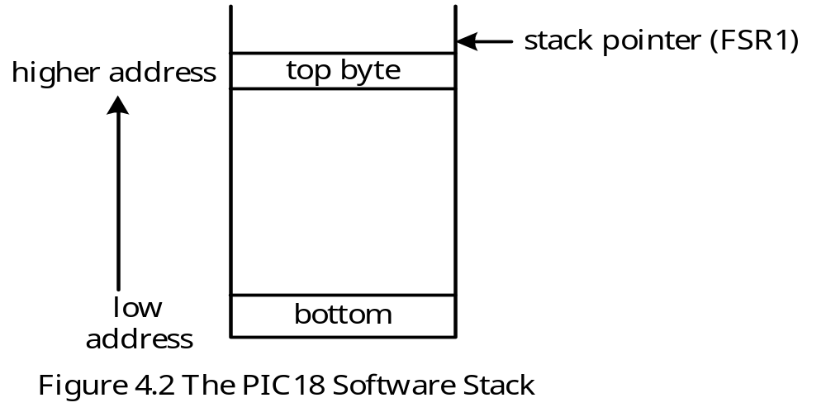
PIC18 Software Stack
PIC18 does not have a hardware stack (no dedicated stack pointer).
One of the FSR registers can be used as the stack pointer. By convention, FSR1 is used as the stack pointer by the PIC18 C compiler.
The PIC18 stack is shown in Figure 4.2

Slide 18
Stack Macros
Push and pop operations are often performed during a subroutine call.
The user often needs to allocate and deallocate stack space during a subroutine call.
Allocation and deallocation of stack space are performed during subroutine calls.
pushr macro arg ; macro to push the arg register
movff arg,POSTINC1
endm
popr macro arg ; arg is a file register
movff POSTDEC1,arg ; decrement the stack pointer
movff INDF1,arg ; pop off a byte from the stack onto arg
endm
push_dat
macro dat ; this macro push the value dat onto the stack
movlw dat
pushr WREG
endm

Slide 19
Stack Macros (continued)
alloc_stk macro n ; this macro allocates n bytes in stack
movlw n
addwf FSR1L,F,A
movlw 0x00
addwfc FSR1H,F,A
endm
dealloc_stk macro n ; this macro deallocates n bytes from stack
movlw n
subwf FSR1L,F,A
movlw 0
subwfb FSR1H,F,A ; subtract borrow from high byte of FSR1
endm

Slide 20
Examples of Stack Macros Applications
Push PRODL into the software stack
pushr PRODL
Pop PRODL from the software stack
popr PRODL
Push the value 0x20 onto the software stack
push_dat 0x20
Allocate 10 bytes of stack space
alloc_stk 10
Deallocate 10 bytes from the stack
dealloc_stk 10

Slide 21
Subroutines
A sequence of instructions that can be called from many different places in a program.
Parameters can be passed to the subroutine so that it can perform operations on different variables.
Allows the user to use divide-and-conquer strategy to solve complicated problems.
Using subroutines can in some cases reduce the code size significantly.
Structured Programming methodology
Start with a main program that outlines the logical flow of the algorithm
Assign program details to subroutines
A subroutine may also call other subroutines

Slide 22
PIC18 Mechanisms to Support Subroutine Calls
A 31-slot return address stack for saving and restoring return address
A return address stack pointer points to the top of the return address stack.
The push and pull instructions for pushing values onto the return address stack and pulling values into program counter from the return address stack
A one-layer deep fast register stack for fast saving and restoring the STATUS, WREG, and BSR registers during interrupts and subroutine calls
The rcall n and call k[,s] instructions for making subroutine calls.
The return [s] instruction for returning from the subroutine
The retlw n instruction for table lookup
The s bit option allows one to save WREG, STATUS, and BSR in the fast register stack when making subroutine calls and restore them before returning from the subroutine

Slide 23
The CALL n[,s] Instruction
- A 2-cycle, 32-bit instruction
n is a 20-bit value that specifies the word address of the subroutine.
The s bit allows the PIC18 to save WREG, STATUS, BSR in the fast register stack.
The RCALL n instruction
n is an 11-bit signed integer that specifies the distance of the subroutine to be called.
Allows the PIC18 to call a subroutine that is 1-KW away
The address of the subroutine to be called is at PC+2+2n.
A 16-bit, two-cycle instruction

Slide 24
The return [s] instruction
Return from subroutine
When s is 1, the contents of the fast return stack will be popped off to WREG, STATUS, and BSR registers.
The top entry of the return address stack will be popped off and loaded into the PC.
The retlw k instruction
The WREG register is loaded with k.
The top entry of the return address stack will be popped off and loaded into the PC.

Slide 25
Examples of Subroutine Calls and Returns
call sub_x, FAST ; save BSR, STATUS, and WREG in fast
… ; register stack
…
sub_x …
…
return FAST ; restore values saved in fast register stack
Table Lookup Instruction: retlw
movlw i ; prepare to lookup the ith entry
call look_up
…
…
look_up addwf PCL ; jump to one of the following entries
retlw k0
retlw k1
…
retlw kn ; end of table

Slide 26
Issues Related to Subroutine Calls
- Parameter passing.
1. Use general-purpose registers
2. Use the stack
3. Use global memory (same as method 1 for PIC18)
Result returning
1. Use general-purpose registers
2. Use the stack
3. Use global memory (same as method 1 for PIC18)
Allocation and deallocation of local variables
1. Local variables are allocated when the subroutine is entered.
2. Local variables are deallocated before returning from the subroutine

Slide 27
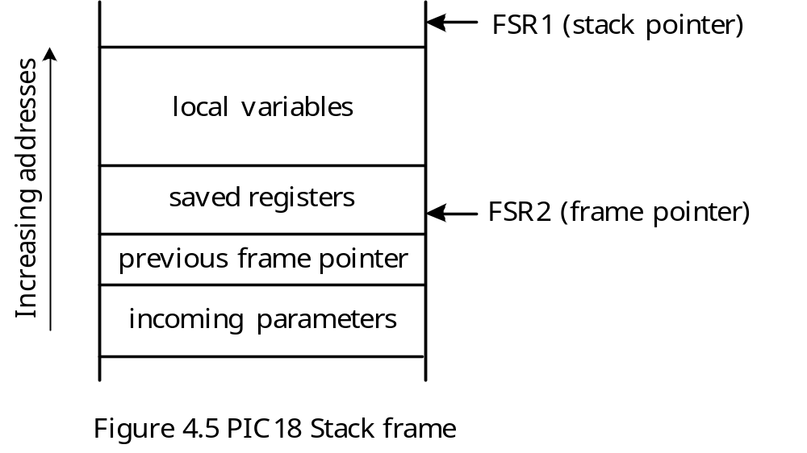
The Stack Frame
Stack frame is a data structure that holds the incoming parameters, saved registers, and local variables for the subroutine.
A frame pointer is beneficial for managing the stack frame.
The stack pointer may change during the lifetime of a subroutine, which sometimes makes the access of stack element tricky.
The frame pointer points to a fixed location in the stack and does not change during the lifetime of the subroutine.
By convention, the FSR2 register is used as the frame pointer.
The PIC18 stack frame is shown in Figure 4.5.

Slide 28
Functioning of the Stack Frame
Upon entry to a subroutine, the value of FSR2 is pushed onto the stack and the value of FSR1 is copied into FSR2.
Some registers are pushed onto the stack.
Local variables are allocated in the stack.
Incoming parameters have negative offsets relative to the FSR2 register.
Local variables have positive offsets relative to FSR2.

Slide 29
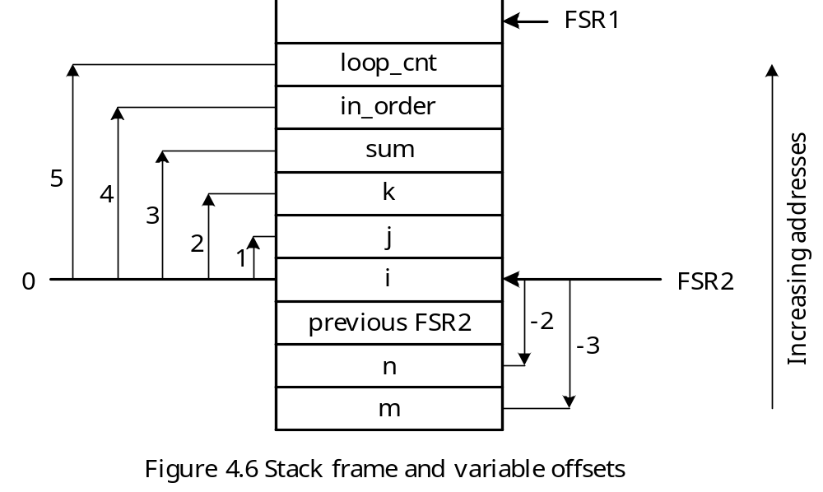
A stack frame example

Slide 30
Accessing Locations in the Stack Frame
Each stack frame slot has an offset relative to the slot pointed to by FSR2
Assign a name to each stack frame slot by using the equ directive
Execute the movf PLUSW2,W instruction
loop_cnt equ 5 ; offset of loop_cnt from frame pointer
in_order equ 4 ; offset of in_order from frame pointer
sum equ 3 ; offset of sum from frame pointer
k equ 2 ; offset of k from frame pointer
j equ 1 ; offset of j from frame pointer
i equ 0 ; offset of i from frame pointer
n equ -2 ; offset of n from frame pointer
m equ -3 ; offset of m from frame pointer
; loading sum into WREG
movlw sum
movf PLUSW2,W
; loading m into WREG
movlw m
movf PLUSW2,W

Slide 31
Example 4.9 Write a subroutine to find the maximum element of an array of 8-bit elements in program memory. Pass the array count and starting address in the software stack.
Solution:
The caller of this subroutine will
Push the low part of the array starting address onto the stack.
Push the high part of the array starting address onto the stack.
Push the upper part of the array starting address onto the stack.
Push the array count onto the stack.
The subroutine will
Push FSR2L and FSR2H onto the stack
Copy FSR1 to FSR2
Push TBLPTRL, TBLPTRH, and TBLPTRU onto the stack
Allocate two bytes in the stack for local variables (one byte for lp_cnt, and one byte for ar_max
These operations need planning and thinking.

Slide 32
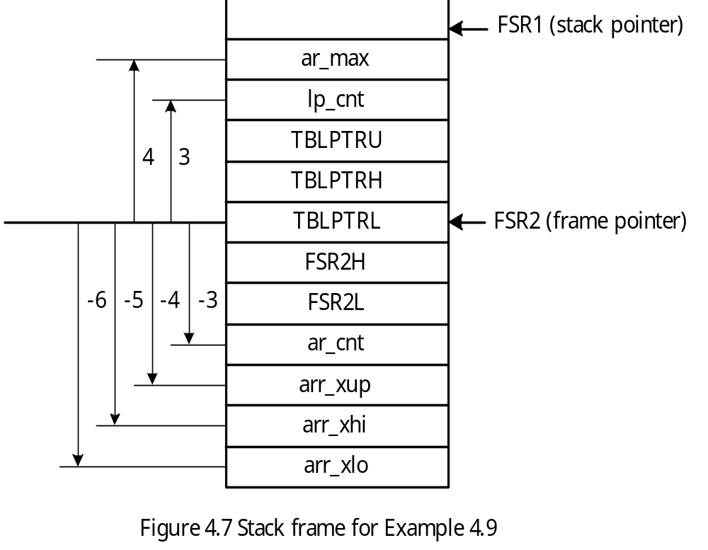

Slide 33
#include <p18F8720.inc>
radix dec
acnt equ 32 ; array count
lp_cnt equ 3 ; stack frame offset for lp_cnt
ar_max equ 4 ; stack frame offset for array max
ar_cnt equ -3 ; stack frame offset for array count
arr_xup equ -4 ; stack frame offset for array base
arr_xhi equ -5 ; "
arr_xlo equ -6 ; "
array_max set 0x00 ; register to hold array max
org 0x00 ; reset vector
goto start
org 0x08
retfie
org 0x18
retfie
start lfsr FSR1,0xE00 ; set up software stack pointer
movlw low arr_x ; pass array base in the stack
pushr WREG ; "
movlw high arr_x ; "
pushr WREG ; "
movlw upper arr_x ; "

Slide 34
pushr WREG ; "
movlw acnt ; pass array count in stack
pushr WREG ; "
call find_amax,FAST ; call the subroutine
movff PRODL,array_max ; save the result
dealloc_stk 4 ; clean up the allocated stack space
nop
here bra here
; ************************************************************************
; This subroutine finds the maximum element of an 8-bit array and returns it in PRODL.
; ************************************************************************
find_max pushr FSR2L ; save caller’s frame pointer
pushr FSR2H ; “
movff FSR1L,FSR2L ; set up new frame pointer
movff FSR1H,FSR2H ; “
pushr TBLPTRL ; save table pointer in stack
pushr TBLPTRH ; “
pushr TBLPTRU ; “
alloc_stk 2 ; allocate 2 bytes for local variables
movlw ar_cnt
movff PLUSW2,PRODL ; copy array count into PRODL

Slide 35
decf PRODL,F,A
movlw lp_cnt
movff PRODL,PLUSW2 ; initialize lp_cnt to arcnt-1
movlw arr_xlo ; place array pointer in TBLPTR
movff PLUSW2,TBLPTRL ; "
movlw arr_xhi ; "
movff PLUSW2,TBLPTRH ; "
movlw arr_xup ; "
movff PLUSW2,TBLPTRU ; "
tblrd*+ ; assign arr_x[0] as the initial array max
movlw ar_max ; "
movff TABLAT,PLUSW2 ; "
cmp_lp movlw lp_cnt
tstfsz PLUSW2
goto next
goto done
next movlw lp_cnt
decf PLUSW2,F ; decrement the loop index
tblrd*+ ; read in the next array element
movlw ar_max
movf PLUSW2,W,A
cpfsgt TABLAT

Slide 36
movlw ar_max
movff TABLAT,PLUSW2 ; update the current array max
goto cmp_lp
done movlw ar_max
movff PLUSW2,PRODL
dealloc_stk 2 ; deallocate local variables
popr TBLPTRU
popr TBLPTRH
popr TBLPTRL
popr FSR2H
popr FSR2L
return FAST
; define an array of 32 8-bit elements.
arr_x db 1,2,3,4,5,6,7,8,9,10,11,12,13,14,15,16
db 17,18,19,20,21,22,23,24,25,26,27,28,29,30,31,32
end

Slide 37
Binary Search
Searching an array or a file is a common operation.
An efficient search algorithm can be applied to a sorted array or file.
Binary search is a very efficient search algorithm.
Divide the sorted array into three parts: upper half, middle element, and lower half.
Use three array indices to guide the search of the array: min, mean, and max.
The index min refers to the lowest array index for searching.
The index max refers to the highest array index for searching.
The index mean is the average of min and max.

Slide 38
Binary Search Algorithm
Step 1
Use max and min as the upper and lower indices of the array for searching and initialize max and min to n – 1 and 0, respectively.
Step 2
If max < min, then stop. No element matches the key.
Step 3
Let mean = (min + max)/2.
Step 4
If key = array_y[mean], then key is found; stop.
Step 5
If key < array_y[mean], then set max to mean –1 and go to Step 2.
Step 6
If key > array_y[mean], then set min to mean +1 and go to Step 2.

Slide 39
Example 4.10 Write a subroutine to implement the binary search algorithm. The starting address of the array, array count, and search key are passed in the stack. A value of 1 will be returned in PRODL if the key is found in the array. Otherwise, a value of 0 will be returned.
Solution:
- This subroutine saves the table pointer in the stack and allocates four bytes for local variables.

Slide 40
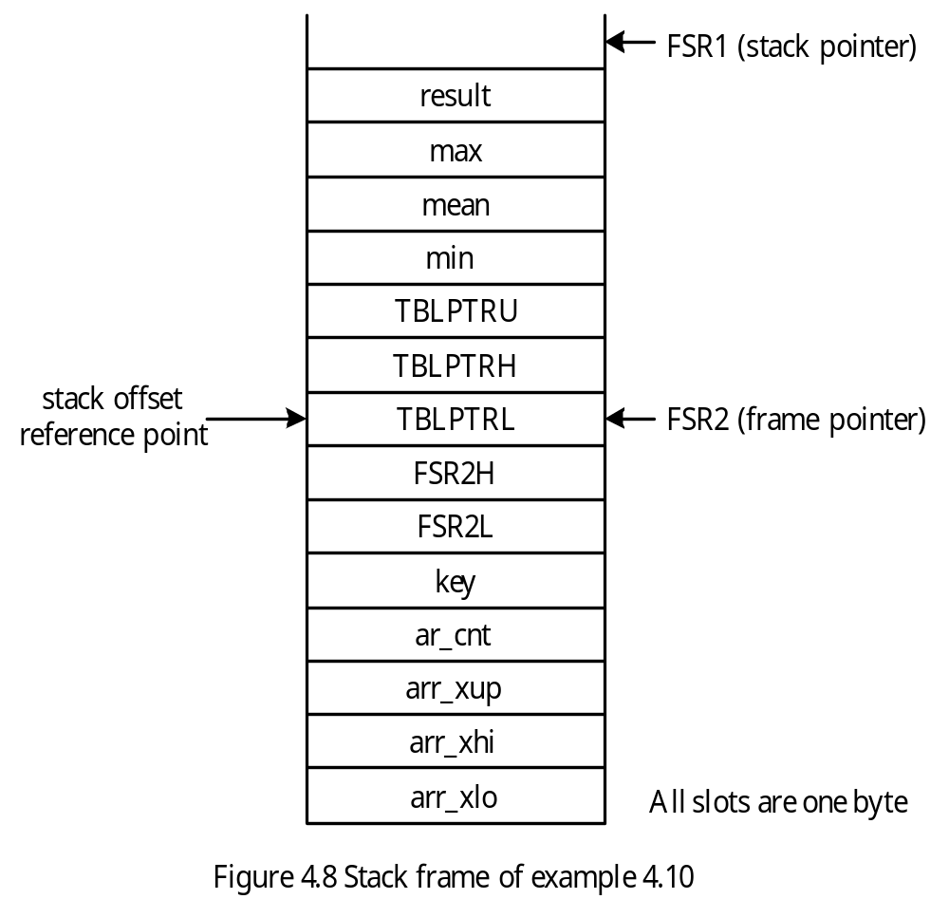

Slide 41
Binary Search Subroutine and Test Program
#include <p18F8720.inc>
radix dec
; -----
; include stack macros pushr, push_dat, popr, alloc_stk, and dealloc_stk here
; -----
acnt equ 32 ; array count
local_var equ 4 ; number of bytes for local variables
skey equ 7 ; key for search
min equ 3 ; offset for lower bound of search range index
mean equ 4 ; offset for middle element index
max equ 5 ; offset for upper bound of search range index
result equ 6 ; offset for search result
key equ -3 ; offset for search key
ar_cnt equ -4 ; stack frame offset for array count
arr_xup equ -5 ; stack frame offset for array base
arr_xhi equ -6 ; "
arr_xlo equ -7 ; "
find_it set 0x00 ; register to hold array max
org 0x00 ; reset vector
goto start
org 0x08
retfie

Slide 42
org 0x18
retfie
start lfsr FSR1,0xE00 ; set up software stack pointer
movlw low arr_x ; pass array base in the stack
pushr WREG ; "
movlw high arr_x ; "
pushr WREG ; "
movlw upper arr_x ; "
pushr WREG ; "
movlw acnt ; pass array count in stack
pushr WREG ; "
movlw skey ; pass key for search
pushr WREG
call bin_search,FAST ; call the subroutine
movff PRODL,find_it ; save the result
dealloc_stk 5 ; clean up the stack space used by parameters
nop
here bra here
bin_search pushr FSR2L ; save callers frame pointer
pushr FSR2H ; "
movff FSR1L,FSR2L ; set up frame pointer
movff FSR1H,FSR2H ; "

Slide 43
pushr TBLPTRL ; save table pointer in stack
pushr TBLPTRH ; "
pushr TBLPTRU ; "
alloc_stk local_var ; allocate space for local variables
movlw ar_cnt ; max ← (ar_cnt – 1)
movff PLUSW2,PRODL ; "
decf PRODL,F,A ; "
movlw max ; "
movff PRODL,PLUSW2 ; "
movlw min ; min ← 0
clrf PLUSW2,A ; "
movlw result
clrf PLUSW2 ; set the search result to not found
bloop movlw max
movff PLUSW2,PRODL ; place max index in PRODL
movlw min
movff PLUSW2,WREG ; place min index in W
cpfslt PRODL ; is max < min?
goto do_it ; max >= min and continue
goto done ; no match is found in the array
do_it addwf PRODL,F,A ; compute (min+max), this may set C flag
bcf STATUS,C ; compute (min+max)/2 and place it

Slide 44
rrcf PRODL,F,A ; in PRODL
movlw mean
movff PRODL,PLUSW2 ; place mean index in the stack frame slot
; compare array[mean] with the search key
movlw arr_xlo ; place array base in TBLPTR
movff PLUSW2,TBLPTRL ; "
movlw arr_xhi ; "
movff PLUSW2,TBLPTRH ; "
movlw arr_xup ; "
movff PLUSW2,TBLPTRU ; "
; add mean to TBLPTR to compute the address of arr_x[mean]
movf PRODL,W,A ; add lower 8 bits of mean to
addwf TBLPTRL,F,A ; TBLPTR
movlw 0 ; "
addwfc TBLPTRH,F,A ; "
addwfc TBLPTRU,F,A ; "
tblrd* ; read array[mean] into TABLAT
; compare key with array[mean]
movlw key
movf PLUSW2,W,A ; place key in WREG
cpfseq TABLAT,A
goto not_equal

Slide 45
movlw result
incf PLUSW2,F ; set search result to "found"
goto done
not_equal cpfslt TABLAT,A
goto go_low
movlw mean
movff PLUSW2,PRODL
incf PRODL,F,A
movlw min
movff PRODL,PLUSW2 ; set min to mean+1 to
goto bloop ; search upper half
go_low movlw mean
movff PLUSW2,PRODL
decf PRODL,F,A
movlw max
movff PRODL,PLUSW2 ; set max to mean - 1 and
goto bloop ; search lower half
done movlw result
movff PLUSW2,PRODL ; place the result in PRODL before return
dealloc_stk local_var ; deallocate local variables
popr TBLPTRU
popr TBLPTRH

Slide 46
popr TBLPTRL
popr FSR2H
popr FSR2L
return FAST
; define an array of 32 8-bit elements for testing purpose. The element arr_x[i] is
; located at arr_x[0] + i
arr_x db 1,2,3,4,5,6,7,8,9,10
db 11,12,13,14,15,16,17,18,19,20
db 21,22,23,24,25,26,27,28,29,30
db 31,32
end

Slide 47
Example 4.11 Convert the unsigned 16-bit division program into a subroutine. The caller of this subroutine will push the dividend and divisor into the stack and make a hole in the stack for this subroutine to return the remainder and the quotient.
Solution:
The caller of this subroutine will do the following
Push the dividend onto the stack
Make a hole of two bytes to hold the remainder
Push the divisor onto the stack
The divu16 subroutine will do the following
Push the FSR2 onto the stack
Copy FSR1 to FSR2 (set up new frame pointer)
Save PRODL in the stack
Allocate space for local variables
The stack frame of this subroutine is shown in Figure 4.9.

Slide 48
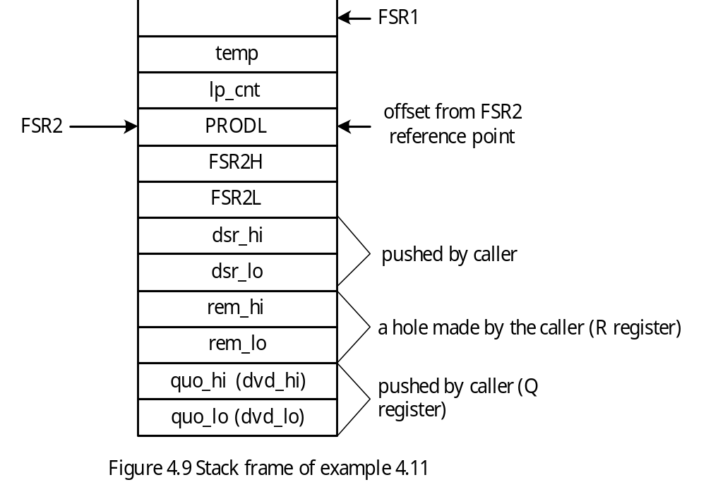

Slide 49
#include <p18F8720.inc>
radix dec
; ---
; include macros pushr, popr, alloc_stk, and dealloc_stk here
; ---
loc_var equ 2 ; local variable size
lp_cnt equ 1 ; loop count
temp equ 2 ; temporary storage
quo_hi equ -7 ; offset for quotient and dividend
quo_lo equ -8 ; "
rem_hi equ -5 ; offset for remainder
rem_lo equ -6 ; "
dsr_hi equ -3 ; offset for divisor
dsr_lo equ -4 ; "
dd_h equ 0xEC ; high byte of dividend test number
dd_l equ 0x46 ; low byte of "
dr_h equ 0x00 ; high byte of divisor test number
dr_l equ 0x87 ; low byte of "
quo set 0x00 ; memory space to hold the quotient
rem set 0x02 ; memory space to hold the remainder
org 0x00
goto start

Slide 50
div16u pushr FSR2L ; save the previous frame pointer
pushr FSR2H ; "
movff FSR1L,FSR2L ; set up frame pointer
movff FSR1H,FSR2H ; "
pushr PRODL ; save PRODL in stack
alloc_stk loc_var ; allocate space for local variables
movlw rem_hi ; clear R register to 0
clrf PLUSW2 ; "
movlw rem_lo ; "
clrf PLUSW2 ; "
movlw 16 ; initialize loop count to 16
movwf PRODL ; "
movlw lp_cnt ; "
movff PRODL,PLUSW2 ; "
loop bcf STATUS,C,A ; clear the C flag
movlw quo_lo ; rotate (R, Q) pair to the left one place
rlcf PLUSW2,F ; "
movlw quo_hi ; "
rlcf PLUSW2,F ; "
movlw rem_lo ; "
rlcf PLUSW2,F ; "
movlw rem_hi ; "

Slide 51
rlcf PLUSW2,F ; "
movlw rem_lo ; get the low byte of the remainder in
movff PLUSW2,PRODL ; PRODL
movlw dsr_lo ; get the low byte of the divisor in WREG
movf PLUSW2,W ; "
subwf PRODL,F,A
movlw temp
movff PRODL,PLUSW2 ; save the low byte of difference at temp
movlw rem_hi
movff PLUSW2,PRODL
movlw dsr_hi
movf PLUSW2,W
subwfb PRODL,F ; subtract the high byte
btfss STATUS,C ; skip if carry is 1
goto less
movlw quo_lo
bsf PLUSW2,0 ; set the quotient bit to 1
movlw rem_hi
movff PRODL,PLUSW2 ; place the difference in the R register
movlw temp ; "
movff PLUSW2,PRODL ; "
movlw rem_lo ; "

Slide 52
movff PRODL,PLUSW2 ; "
goto next
less movlw quo_lo
bcf PLUSW2,0 ; set the quotient bit to 0
next movlw lp_cnt
decfsz PLUSW2,F ; decrement the loop count and skip if zero
goto loop
dealloc_stk loc_var ; deallocate local variables
popr PRODL
popr FSR2H
popr FSR2L
return FAST
end

Slide 53
String Processing
A string is a sequence of characters terminated by a NULL character.
A character is encoded in ASCII code.
Strings are needed in input and output.
A number must be converted to ASCII code before it can be output.
The decimal number 10805 will be converted to 0x31 0x30 0x38 0x30 0x35
A binary number can be converted to its equivalent decimal string by performing repeated division by 10.
The remainder of the first division is the least significant digit, the last division will separate the most significant digit and second most significant digit.

Slide 54
Example 4.12 Write a subroutine to convert a 16-bit signed number to an ASCII string
that represents its equivalent decimal value.
Solution: Let p, rem, quo, and sign represent the integer to be converted, remainder after the divide-by-10 operation, the quotient after the divide-by-10 operation, and the sign of p, respectively. The algorithm for converting a binary number into a decimal string is as follows:
Step 1
If p = 0, then store $30 and $00 in the buffer and stop.
Step 2
If p < 0, then set sign to 1 and compute p’s 2’s complement. Otherwise, set sign to 0.
Step 3
Divide p by 10 and leave the remainder and the quotient in rem and quo, respectively.
Step 4
Add $30 to the remainder and save it in the next available space in the buffer.
Step 5
If quo ≠ 0 then p ← quo and go to Step 3.
Step 6
Push the characters in the buffer into the stack.
Step 7
If sign is 1, then store the ASCII code of the minus sign as the first character in the buffer.
Step 8
Pop out all the decimal digits from the stack into the buffer.

Slide 55
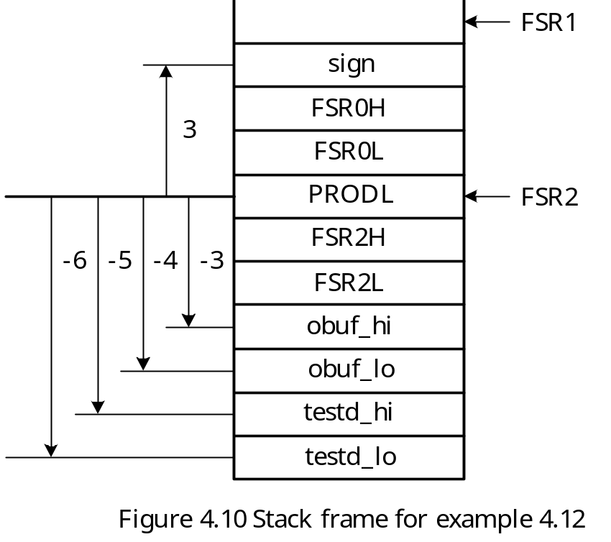
The stack frame of this subroutine is in Figure 4.10.

Slide 56
#include <p18F8720.inc>
radix dec ; set default radix to decimal
; ---
; include macro definitions of pushr, popr, push_dat, alloc_stk, and dealloc_stk here
; ---
tstd_hi equ 0x88 ; test data high byte
tstd_lo equ 0x89 ; test data low byte
sign equ 3 ; stack offset for sign in bin2dec
testd_lo equ -6 ; stack offset for test data in bin2dec
testd_hi equ -5 ; "
obuf_lo equ -4 ; stack offset for conversion buffer
obuf_hi equ -3 ; "
minus equ 0x2D ; ASCII code of minus sign
loc_varc equ 1 ; local variable size of bin2dec routine
obuf set 0x0100
org 0x00
goto start

Slide 57
The test program is as follows:
org 0x08 ; high-priority interrupt vector
retfie
org 0x18 ; low-priority interrupt vector
retfie
start lfsr FSR1,0xE00 ; set up stack pointer
push_dat tstd_lo ; pass test data in stack
push_dat tstd_hi ; "
push_dat low obuf ; "
push_dat high obuf ; "
call bin2dec,FAST ; call bin2dec subroutine
dealloc_stk 4 ; clean up stack space
con_loop nop
bra con_loop

Slide 58
bin2dec pushr FSR2L ; save previous frame pointer
pushr FSR2H ; "
movff FSR1L,FSR2L ; set up new frame pointer
movff FSR1H,FSR2H ; "
pushr PRODL
pushr FSR0L ; save FSR0 in stack
pushr FSR0H ; "
alloc_stk loc_varc ; allocate local variable space
; set FSR0 as the pointer to the buffer that holds the conversion result
movlw obuf_lo
movff PLUSW2,FSR0L
movlw obuf_hi
movff PLUSW2,FSR0H
; initialize the sign of the number to be converted to positive
movlw sign ; "
clrf PLUSW2 ; "
; test to find out if the number is negative. If yes, compute its
; two's complement.
movlw testd_hi
btfss PLUSW2,7 ; compute the magnitude when negative
goto tst_zero ; no need to complement when positive
comf PLUSW2,F ; complement the upper byte when negative

Slide 59
clrf PRODL,A ; add carry to testd_hi (carry may be 0)
movlw testd_lo ; compute the two's complement of data
negf PLUSW2 ; to be converted
movlw testd_hi ; "
movf PLUSW2,W ; "
addwfc PRODL,F ; "
movlw testd_hi ; "
movff PRODL,PLUSW2 ; "
; change sign to 1 to indicate minus
movlw sign ; "
incf PLUSW2,F ; "
bra normal
; check if the number to be tested is zero
tst_zero movlw testd_hi ; test high byte
tstfsz PLUSW2 ; “
bra normal
movlw testd_lo ; test low byte
tstfsz PLUSW2 ; “
bra normal
movlw 0x30
movwf POSTINC0
clrf INDF0 ; terminate the buffer with NULL character

Slide 60
goto done
; normal repeated divide-by-10 loop starts here
normal movlw testd_lo ; pass the dividend
movf PLUSW2,W ; "
pushr WREG ; "
movlw testd_hi ; "
movf PLUSW2,W ; "
pushr WREG ; "
div_lp alloc_stk 2 ; make room for remainder
push_dat 10 ; push 10 into the stack as divisor
push_dat 0 ; "
call div16u ; call subroutine to perform division
dealloc_stk 3 ; deallocate the stack space (3 bytes remain)
popr WREG ; pop off low byte of remainder
addlw 0x30 ; convert the remainder into ASCII code
movwf POSTINC0 ; and save it in buffer
; is quotient equal to 0?
movlw -1
tstfsz PLUSW1
goto div_lp
movlw -2
tstfsz PLUSW1

Slide 61
goto div_lp
clrf INDF0 ; terminate the buffer with NULL
dealloc_stk 2 ; clean up the stack
; set FSR0 to point to the start of the buffer to reverse the string
movlw obuf_lo ; "
movff PLUSW2,FSR0L ; "
movlw obuf_hi ; "
movff PLUSW2,FSR0H ; "
push_dat 0 ; push a NULL character onto the stack
push_lp movf POSTINC0,W
bz to_pop ; is this the NULL character
pushr WREG
goto push_lp
; reverse the converted string
to_pop movlw obuf_lo ; set FSR0 to point to the start of buffer
movff PLUSW2,FSR0L ; "
movlw obuf_hi ; "
movff PLUSW2,FSR0H ; "
movlw sign
movf PLUSW2,W ; is the converted data negative?
bz pop_loop ; "
; add a minus sign if the number is negative

Slide 62
movlw minus
movwf POSTINC0
pop_loop popr WREG ; reverse string loop
movwf POSTINC0
tstfsz WREG,A ; reach the end of string?
goto pop_loop
done popr WREG ; get rid of sign
popr FSR0H
popr FSR0L
popr PRODL
popr FSR2H
popr FSR2L
return FAST

Slide 63
Example 4.13 Write a subroutine that computes the product of two unsigned 16-bit integers. The numbers to be multiplied and the pointer to the buffer for storing the product are passed in the stack.
Solution: The subroutine will save all the used registers in the stack and allocates four bytes for local variables to hold the product. The stack frame is shown in Figure 4.11.

Slide 64
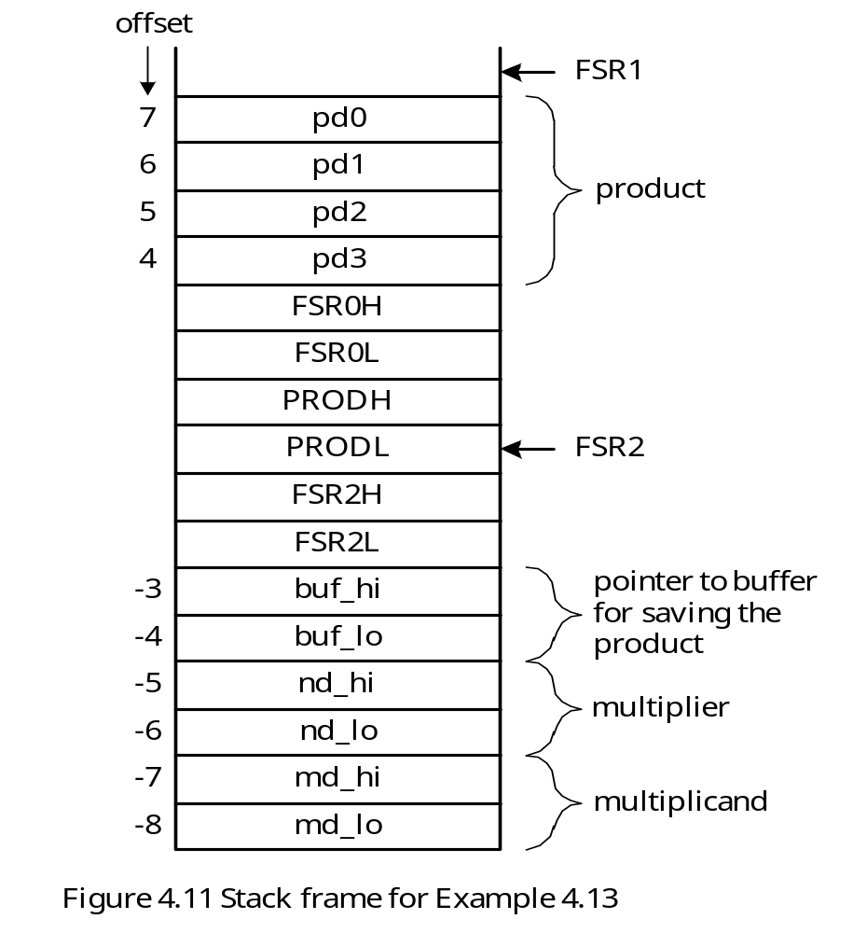

Slide 65
mul_16u pushr FSR2L ; save previous frame pointer
pushr FSR2H ; "
movff FSR1L,FSR2L ; set up new frame pointer
movff FSR1H,FSR2H ; "
pushr PRODL ; save PRODL in stack
pushr PRODH ; save PRODH in stack
pushr FSR0L ; save FSR0 in stack
pushr FSR0H ; "
alloc_stk loc_varm
; compute md_lo × nd_lo and place in pd1..pd0
movlw md_lo
movff PLUSW2,PRODL ; place md_lo in PRDOL
movlw nd_lo
movf PLUSW2,W ; place nd_lo in WREG
mulwf PRODL ; compute nd_lo * md_lo
movlw pd0
movff PRODL,PLUSW2
movlw pd1
movff PRODH,PLUSW2
; compute md_hi × nd_hi and place the product in pd3..pd2
movlw md_hi
movff PLUSW2,PRODL ; place md_hi in PRODL

Slide 66
movlw nd_hi
movf PLUSW2,W ; place nd_hi in WREG
mulwf PRODL ; compute nd_hi * md_hi
movlw pd2
movff PRODL,PLUSW2
movlw pd3
movff PRODH,PLUSW2
; compute md_lo × nd_hi
movlw md_lo
movff PLUSW2,PRODL
movlw nd_hi
movf PLUSW2,W
mulwf PRODL
movlw pd1 ; add to pd1
movf PLUSW2,W ; "
addwf PRODL,F ; "
movlw pd1 ; "
movff PRODL,PLUSW2 ; "
movlw pd2
movf PLUSW2,W
addwfc PRODH,F
movlw pd2

Slide 67
movff PRODH,PLUSW2 ;
clrf PRODL
movlw pd3
movf PLUSW2,W
addwfc PRODL,F
movlw pd3
movff PRODL,PLUSW2
; compute md_hi × nd_lo
movlw md_hi
movff PLUSW2,PRODL
movlw nd_lo
movf PLUSW2,W
mulwf PRODL
movlw pd1 ; add to pd1
movf PLUSW2,W ; "
addwf PRODL,F ; "
movlw pd1 ; "
movff PRODL,PLUSW2 ; "
movlw pd2 ; add to pd2
movf PLUSW2,W ; “
addwfc PRODH,F ; “
movlw pd2 ; “

Slide 68
movff PRODH,PLUSW2 ; “
clrf PRODL ; add carry to most significant byte
movlw pd3 ; “
movf PLUSW2,W ; “
addwfc PRODL,F ; “
movlw pd3 ; “
movff PRODL,PLUSW2 ; “
; use FSR0 as a pointer to the buffer that holds the product
movlw buf_lo
movff PLUSW2,FSR0L
movlw buf_hi
movff PLUSW2,FSR0H
; save product in the buffer
popr WREG
movwf POSTINC0
popr WREG
movwf POSTINC0
popr WREG
movwf POSTINC0
popr WREG
movwf POSTINC0
popr FSR0H

Slide 69
popr FSR0L
popr PRODH
popr PRODL
popr FSR2H
popr FSR2L
return FAST
end
Input Data Conversion Issue
A number entered from the keyboard is encoded in ASCII code.
Each input character represents a decimal digit.
The input number can be positive or negative.
A negative number is entered using signed magnitude format.
Illegal characters must be checked.
The following algorithm uses three variables to facilitate the conversion:
sign: keeps track of the sign of the number
error: indicates whether the input string has any error
number: stores the converted number

Slide 70
ASCII String to Binary Conversion Algorithm
Step 1
sign ← 0
error ← 0
number ← 0
Step 2
If the character pointed to by in_ptr is the minus sign, then
sign ← 1
in_ptr ← in_ptr + 1
Step 3
If the character pointed to by in_ptr is the NULL character, then go to Step 4.
else if the character is not a BCD digit (i.e., m[in_ptr] > $39 or m[in_ptr] < $30), then
error ← 1;
go to Step 4;
else
number ← number × 10 + m[in_ptr] - $30;
in_ptr ← in_ptr + 1;
go to Step 3;
Step 4
If sign = 1 and error = 0, then
number ← two’s complement of number;
else stop;

Slide 71
Example 4.14 Write a subroutine that converts a decimal digit string into the binary number that it represents. The string is stored in the data memory and its starting address is passed to this function in the FSR0 register. The string may represent a positive or a negative number and is no longer than 7 bytes. Thus, the converted binary number can be accommodated in two bytes. The converted result will be returned in PRODL and PRODH. Do not check for illegal characters.
Solution:
This subroutine needs to call mul_16u subroutine to perform multiplication.
This subroutine passes a pointer to a buffer to hold the product.
The buffer is reserved in the stack frame.

Slide 72
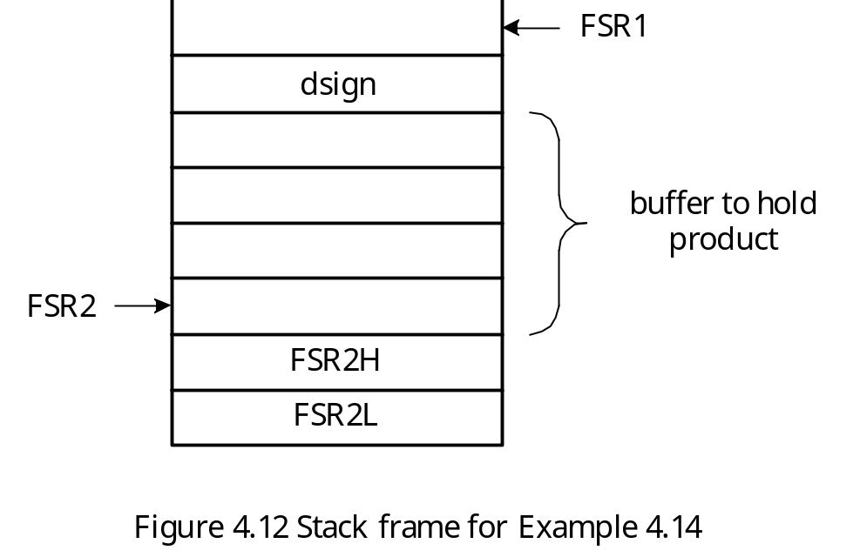
The subroutine is as follows:
loc_vard equ 5 ; size of local variables for d2b
dsign equ 4 ; offset of dsign from FSR2
dec_strg set 0x10 ; address of the buffer for the decimal string

Slide 73
dec2bin pushr FSR2L ; save the current frame pointer
pushr FSR2H ; "
movff FSR1L,FSR2L ; set up new frame pointer
movff FSR1H,FSR2H ; "
alloc_stk loc_vard ; allocate 5 bytes for local variables
movlw 0
clrf PLUSW2 ; clear the buffer that holds the product
incf WREG,W ; "
clrf PLUSW2 ; "
incf WREG,W ; "
clrf PLUSW2 ; "
incf WREG,W ; "
clrf PLUSW2 ; "
movlw dsign ; initialize sign to positive
clrf PLUSW2 ; “
movff INDF0,PRODL ; get a character from string
movlw 0x2D ; place minus sign in WREG
cpfseq PRODL ; is the first character a minus sign?
goto con_lp
movlw dsign
incf PLUSW2 ; set sign to minus
movf POSTINC0,W ; move pointer to next character

Slide 74
con_lp movff POSTINC0,PRODL
tstfsz PRODL,A ; reach the NULL character?
goto normal ; not yet
goto done ; yes, reach NULL character
normal movlw 0x30
subwf PRODL,F,A ; convert to digit value
movlw 0 ; push multiplicand
movf PLUSW2,W ; "
pushr WREG ; "
movlw 1 ; "
movf PLUSW2,W ; "
pushr WREG ; "
push_dat 10 ; push multiplier 10 into stack
push_dat 0 ; "
pushr FSR2L ; push buffer pointer
pushr FSR2H ; "
call mul_16U ; multiply the current result by 10
dealloc_stk 6 ; clean up stack space
movf PRODL,W
addwf INDF2,F ; add the converted digit to the product
clrf PRODL,A ; "
movlw 1

Slide 75
movf PLUSW2,W ; place the upper byte of the product in WREG
addwfc PRODL,F ; "
movlw 1 ; "
movff PRODL,PLUSW2 ; "
goto con_lp
; check the sign of the converted binary number before return
done dealloc_stk 3 ; move down the stack pointer
popr PRODH ; place upper byte of product in PRODH
popr PRODL ; place lower byte of product in PRODL
movlw dsign ; check the sign
tstfsz PLUSW2 ; "
goto negate
goto getback
negate negf PRODL ; find 2's complement of the result
comf PRODH ; "
movlw 0 ; "
addwfc PRODH,F ; "
getback popr FSR2H
popr FSR2L
return
; ----
; include MUL16U and its associated equ directives here.
; ----

Slide 76
Bubble Sort
Sorting makes searching operation easy to perform.
Bubble sort is simple, widely known, but inefficient.
Go through the array or file several iterations with each iteration placing one element in the right position.
The main operation is to compare each array element x[i] with its immediate successor x[i+1] and swap them if they are not in proper order.
For an array of n elements, n – 1 comparisons are performed in the first iteration.
As more and more iterations are performed, more and more elements are in their right positions. Fewer comparisons are needed.
If there is no swapping done during an iteration, then the array is already in order and comparisons can be terminated.

Slide 77
Example 4.15 Write a subroutine to implement the bubble sort algorithm and a sequence of instructions along with a set of test data for testing this subroutine. Use an array in data memory that consists of n 8-bit unsigned integers for testing purpose.
Solution: The bubble sort subroutine needs three local variables:
in_order: a flag indicating whether the array is in order after an iteration
inner: number of comparisons remained to be performed in an iteration
iteration: number of iterations remained to be performed
The caller of bubble sort subroutine pushed the array base address and array count in the stack.
The following program declares an array of n 8-bit elements in program memory and copies it to the data memory for testing purpose.

Slide 78
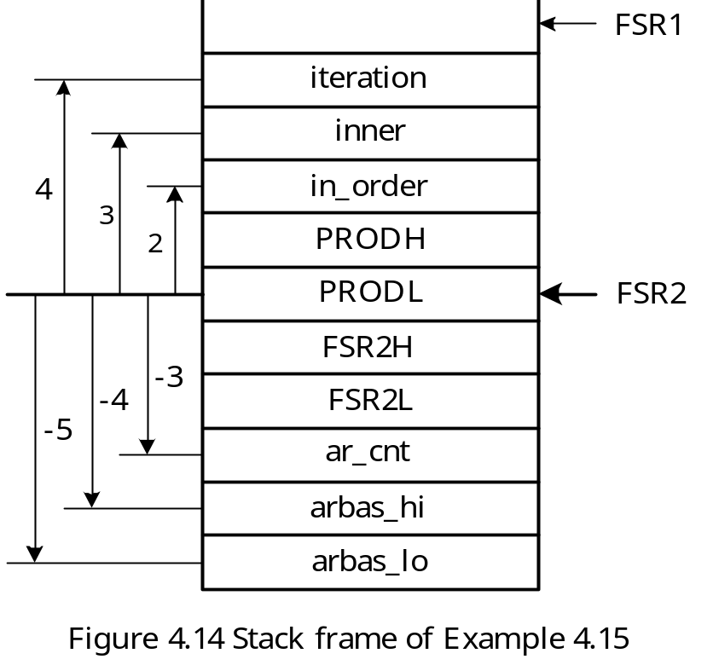

Slide 79
#include <p18F8720.inc>
radix dec
; ----
; include macro definitions pushr, push_dat, popr, alloc_stk, and dealloc_stk here
; ----
NN equ 30 ; array count
loc_varb equ 3 ; number of bytes of local variables
arbas equ 0x0100 ; array base address
lp_cnt set 0 ; use data memory location 0 for loop count
in_order equ 2 ; offset of local variable from frame pointer
inner equ 3 ; "
iteration equ 4 ; "
ar_cnt equ -3 ; "
arbas_hi equ -4 ; "
arbas_lo equ -5 ; "
org 0x00
goto start
org 0x08 ; high-priority interrupt vector
retfie
org 0x18 ; low-priority interrupt vector
retfie

Slide 80
start lfsr FSR1,0xE00 ; set up stack pointer
movlw high arbas ; use FSR0 as the pointer to the array
movwf FSR0H,A ; to be sorted
movlw low arbas ; "
movwf FSR0L,A ; "
movlw upper xarr ; set up table pointer to point to
movwf TBLPTRU,A ; the array in program memory
movlw high xarr ; "
movwf TBLPTRH,A ; "
movlw low xarr ; "
movwf TBLPTRL,A ; "
movlw NN
movwf lp_cnt
; *********************************************************************
; copy an array from program memory to data memory to test the bubble
; sort subroutine.
; *********************************************************************
copy_lp tblrd*+ ; read a byte into the table latch
movff TABLAT,POSTINC0 ; copy one byte
decfsz lp_cnt,F,A
bra copy_lp
movlw low arbas ; push array base address onto stack

Slide 81
pushr WREG ; "
movlw high arbas ; "
pushr WREG ; "
push_dat NN ; push array count
call bubble,FAST ; call the bubble sort function
forever nop
bra forever
bubble pushr FSR2L ; save the current frame pointer
pushr FSR2H ; "
movff FSR1L,FSR2L ; set up new frame pointer
movff FSR1H,FSR2H ; "
pushr PRODL ; save PRODL in stack
pushr PRODH ; save PRODH in stack
alloc_stk loc_varb
movlw ar_cnt
movff PLUSW2,PRODL
decf PRODL,F,A
movlw iteration ; set iteration to array count – 1
movff PRODL,PLUSW2 ; “

Slide 82
ploop movlw in_order
clrf PLUSW2 ; set in_order flag to true (0)
movlw iteration
movff PLUSW2,PRODL
movlw inner
movff PRODL,PLUSW2 ; initialize inner loop count
movlw arbas_lo ; use FSR0 as the array pointer
movff PLUSW2,FSR0L ; "
movlw arbas_hi ; "
movff PLUSW2,FSR0H ; "
cloop movff INDF0,PRODL ; place arr[i] in PRODL
movlw 1
movf PLUSW0,W ; place arr[i+1] in WREG
cpfsgt PRODL,A
goto looptst
movwf PRODH ; swap arr[i] with arr[i+1]
movlw 1 ; "
movff PRODL,PLUSW0 ; "
movff PRODH,INDF0 ; "
movlw in_order ; set the in_order flag to false (1)
incf PLUSW2,F ; “
looptst movf POSTINC0,W ; increment array pointer

Slide 83
movlw inner ; decrement inner loop count and skip if it
decfsz PLUSW2,F ; has been decremented to zero
goto cloop
movlw in_order
tstfsz PLUSW2 ; is the array in order?
goto nexti ; not yet
goto done ; yes, return.
nexti movlw iteration
decfsz PLUSW2,F
goto ploop
done dealloc_stk loc_varb
popr PRODH
popr PRODL
popr FSR2H
popr FSR2L
return FAST
xarr db 0x56,0x1F,0x01,0x08,0x11,0x47,0x21,0x20,0x30,0x07
db 0x19,0x18,0x17,0x16,0x15,0x14,0x13,0x12,0x29,0x28
db 0x27,0x26,0x25,0x24,0x23,0x22,0x06,0x05,0x04,0x03
end

Slide 84
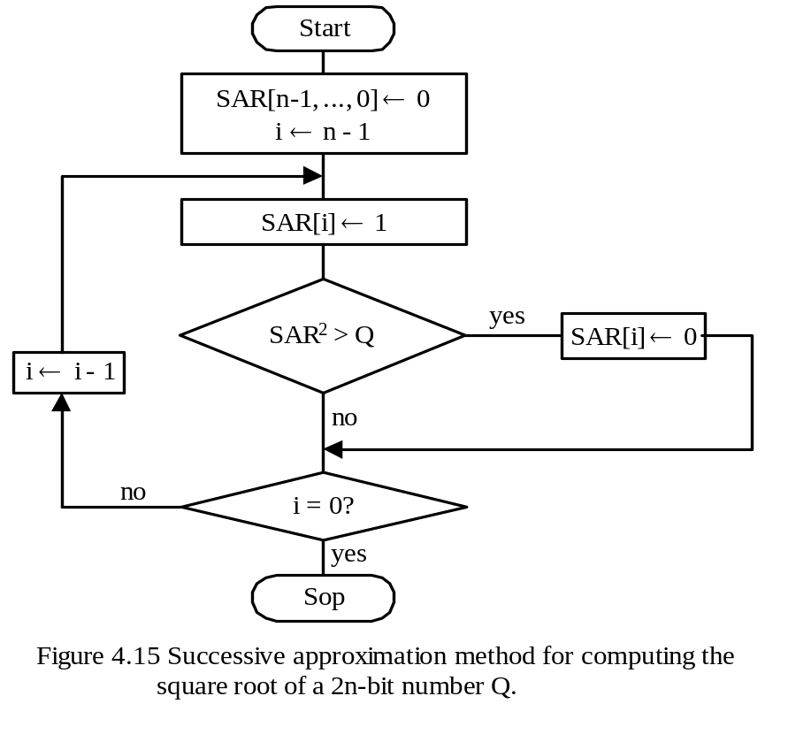
Square Root Computation
- A simple but efficient way to compute the approximate integral square root of an integer is successive approximation method.
The square root of an 2n-bit number would be n-bit.
Let SAR be an n-bit number, Q be a 2n-bit number of which the square root is to be computed.

Slide 85
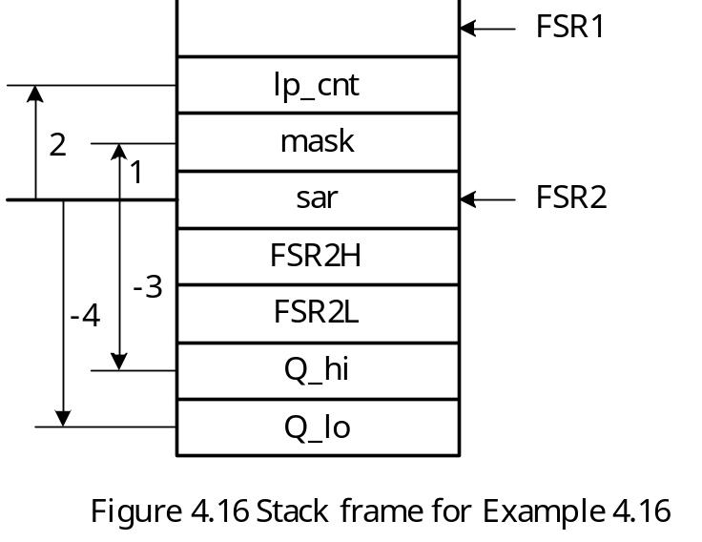
The algorithm in Figure 4.15 computes an approximate integer square root smaller than or equal to the actual one. The better approximation could be [SAR] or [SAR]+1.
The better approximate square root can be found by comparing Q – [SAR*SAR] and ([SAR]+1)*([SAR]+1).
Example 4.16 Write an assembly routine to implement the successive approximation method for computing the square root of a 16-bit integer. The 16-bit integer will be pushed into the stack. The square root is returned in PRODL.
Solution: The subroutine has three local variables:
1. sar: Successive approximation register
2. mask: A value used to set the ith bit
3. lp_cnt: loop count

Slide 86
#include <p18F8720.inc>
radix dec
; ----
; include macro definitions pushr, push_dat, popr, alloc_stk, and dealloc_stk here
; ----
testd_hi equ 0x41 ; data to be tested
testd_lo equ 0x2E ; “
loc_vars equ 3 ; number of bytes for local variable
Q_hi equ -3 ; offsets of Q from frame pointer
Q_lo equ -4 ; “
sar equ 0 ; “
mask equ 1 ; “
lp_cnt equ 2 ; “
sq_root set 0x00 ; memory location to save square root
… ; insert testing program here
find_sqr pushr FSR2L
pushr FSR2H
movff FSR1L,FSR2L
movff FSR1H,FSR2H
alloc_stk loc_vars
movlw 8 ; initialize loop count
movwf PRODL,A ; “

Slide 87
movlw lp_cnt ; "
movff PRODL,PLUSW2 ; "
movlw 0x80 ; start with the mask 0x80
movwf PRODL ; "
movlw mask ; "
movff PRODL,PLUSW2 ; "
clrf INDF2 ; initialize SAR to 0
loop movlw mask
movf PLUSW2,W ; place mask in WREG
iorwf INDF2,W ; set the ith bit of SAR
mulwf WREG,A ; compute SAR*SAR
movlw Q_lo ; compute SAR*SAR - Q
movf PLUSW2,W ; "
subwf PRODL,F ; "
movlw Q_hi ; "
movf PLUSW2,W ; "
subwfb PRODH,F ; "
btfsc STATUS,C ; skip if Q > SAR*SAR
goto nextbit
movlw mask ; the guess is right, so
movf PLUSW2,W ; set bit i of SAR
iorwf INDF2,F ; "

Slide 88
nextbit movlw lp_cnt ; decrement the loop count
decf PLUSW2,F ; "
bz done ; it is done if lp_cnt = 0
bcf STATUS,C,A ; clear the C flag
movlw mask
rrcf PLUSW2,F ; shift the mask to the right
goto loop
; ********************************************************************
; Before return, find out if SAR*SAR or (SAR+1)**2 is closer to Q and
; return [SAR] or [SAR]+1 accordingly.
; ********************************************************************
done movf INDF2,W ; get the estimated square root
mulwf WREG,A ; compute SAR*SAR
movlw Q_lo ; compute SAR*SAR - Q (is < 0)
movf PLUSW2,W ; "
subwf PRODL,F,A ; "
movlw Q_hi ; "
movf PLUSW2,W ; "
subwfb PRODH,F,A ; "
comf PRODH,F,A ; compute the magnitude of
negf PRODL,A ; |SAR*SAR - Q|
movlw 0 ; "

Slide 89
addwfc PRODH,F,A ; "
movlw lp_cnt ; copy |SAR*SAR - Q| into lp_cnt
movff PRODH,PLUSW2 ; and mask
movlw mask ; "
movff PRODL,PLUSW2 ; "
movf INDF2,W ; compute SAR+1
incf WREG,W,A ; "
mulwf WREG,A ; compute (SAR+1)**2
movlw Q_lo ; compute (SAR+1)**2 - Q
movf PLUSW2,W ; and leave the difference in
subwf PRODL,F,A ; PRODH:PRODL
movlw Q_hi ; "
movf PLUSW2,W ; "
subwfb PRODH,F,A ; "
movlw mask ; compare [Q-(SAR*SAR)] with
movf PLUSW2,W ; (SAR+1)**2 - Q
subwf PRODL,F,A ; "
movlw lp_cnt ; "
movf PLUSW2,W ; "
subwfb PRODH,F,A ; "
btfsc STATUS,C ; "
goto sel_SAR ; "

Slide 90
incf INDF2,F ; increment SAR by 1
sel_SAR dealloc_stk 2 ; remove lp_cnt and mask from stack
popr PRODL ; place SAR in PRODL
popr FSR2H
popr FSR2L
return
end
Prime Number Test
An integer is prime if it cannot be divided by any of the prime numbers smaller or equal to its square root.
A less efficient method is to divide the given number by all the integers from 2 to its approximate integral square root.
Example 4.17 Write a subroutine to test whether a 16-bit unsigned integer is a prime number. The integer to be tested is pushed into the stack and the test result is returned in the WREG register. If the number is prime, the subroutine returns a one. Otherwise, it returns a zero.

Slide 91
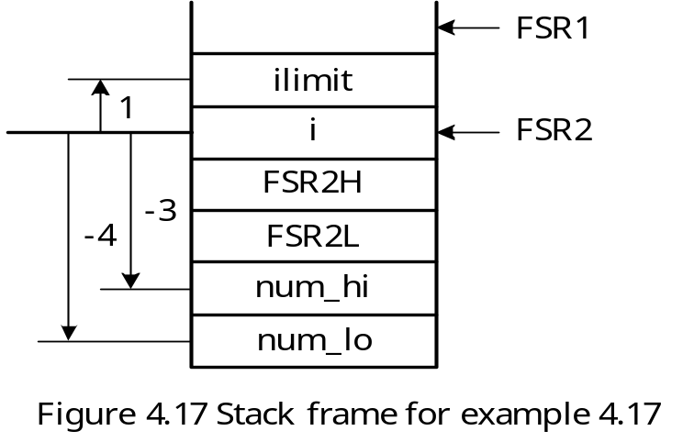
#include <p18F8720.inc>
radix dec
; ----
; include macro definitions pushr, push_dat, popr, alloc_stk, and dealloc_stk here
; ----
loc_varp equ 2 ; local variable size for prime_test
ilimit equ 1 ; offset of ilimit from FSR2
num_hi equ -3 ; offset of test number high byte from FSR2
num_lo equ -4 ; offset of test number low byte from FSR2

Slide 92
prime_tst pushr FSR2L
pushr FSR2H
movff FSR1L,FSR2L ; set up frame pointer
movff FSR1H,FSR2H ; "
alloc_stk loc_varp ; allocate local variables
movlw num_lo ; get a copy of the low byte
movf PLUSW2,W ; of the incoming number
pushr WREG
movlw num_hi ; get a copy of the high byte
movf PLUSW2,W ; "
pushr WREG
call find_sqr ; compute the upper limit for prime test
dealloc_stk 2 ; clean up the pushed data from stack
movlw ilimit ; set up the upper limit for prime
movff PRODL,PLUSW2 ; test
movlw 2
movwf INDF2 ; initialize i to 2
loop movlw ilimit ; place the ilimit in WREG
movf PLUSW2,W ; "
cpfsgt INDF2 ; is i > ilimit?
goto inloop
goto isprime ; it is prime if i > ilimit

Slide 93
inloop movlw num_lo ; push the number to be test for prime
movf PLUSW2,W ; onto the stack
pushr WREG ; "
movlw num_hi ; "
movf PLUSW2,W ; "
pushr WREG ; "
alloc_stk 2 ; allocate two bytes for R register
movf INDF2,W ; get the value of i
pushr WREG ; push i into the stack
push_dat 0 ; push 0 as the upper byte of divisor
call div16u
dealloc_stk 3 ; remove the pushed top three bytes
movlw -1 ; the low byte of the remainder is one
tstfsz PLUSW1 ; below the byte pointed to by FSR1
goto nexti ; remainder is not zero, test next i
goto not_prime
nexti incf INDF2,F
dealloc_stk 3 ; deallocate the pushed remaining 3 bytes
goto loop
not_prime dealloc_stk 2+loc_varp ; deallocate the pushed remaining 3 bytes
; and two bytes of local variables
popr FSR2H
popr FSR2L

Slide 94
movlw 0 ; return a 0 to indicate non_prime
return
isprime dealloc_stk loc_varp ; deallocate local variables
popr FSR2H
popr FSR2L
movlw 1
return
; ----
; include subroutine find_sqr and its associated equ directives here
; ----
; ----
; include subroutine div16u and its associated equ directives here
; ----
end

